Slide 1
 | Theory | Application
Discrete
Continuous
Ito’s formula
Derivation of the Black-Scholes equation
Stochastic differential equations
Markov processes and the Kolmogorov equations

Slide 2
Why Ito’s formula?
Model stock dynamics using stochastic differential equations
Derive an option pricing formula in continuous time
Compute the price of an option
What is Ito’s formula?
Differential representation
Different from ordinal chain rule
Additional term from quadratic variation

Slide 3
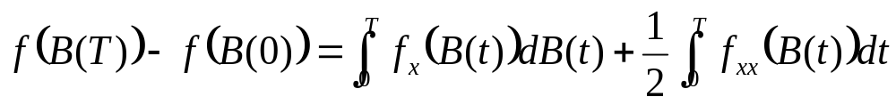

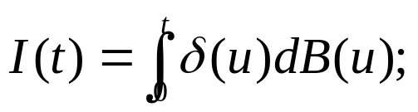

Ito’s formula:
Differential form for Ito’s formula:
- Basic idea:
Taylor’s formula using “Ito’s rule”
Write
“informally”
- Provides a “shortcut”

Slide 4
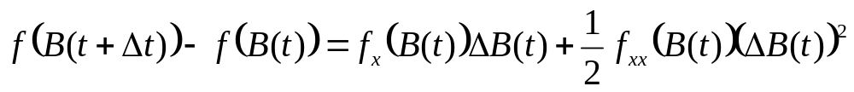
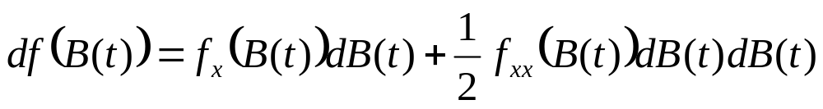
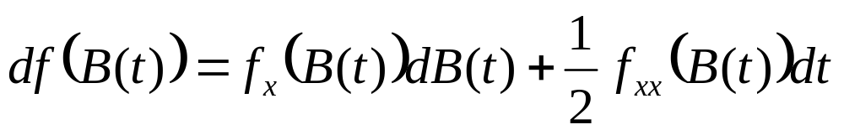
- Step 1: Use Taylor’s formula
- Step 2: Take Δt sufficiently small, and write
- Step 3: Apply Ito’s rule:
- Step 4: Integrate this from 0 to T…

Slide 5
Differential vs. Integral forms:
Ito’s formula in differential form:
- More convenient,
- Easier to compute
Ito’s formula in integral form
- Solid definitions for both the integrals
- Mathematically well-defined

Slide 6
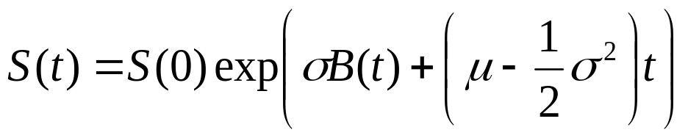
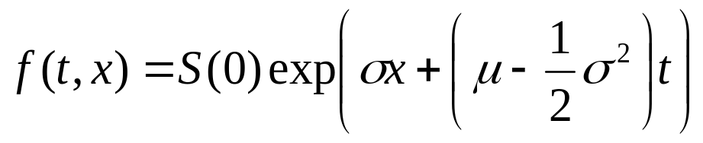
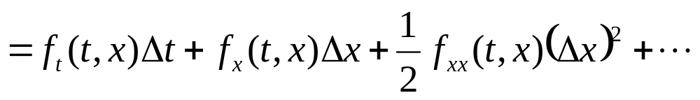


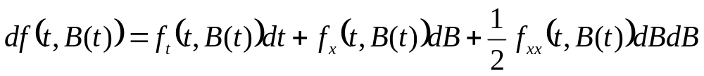
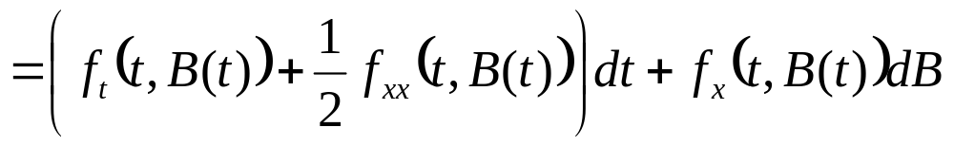
Geometric Brownian motion:
Apply Ito’s formula to get differential form
- Ito’s formula:

Slide 7
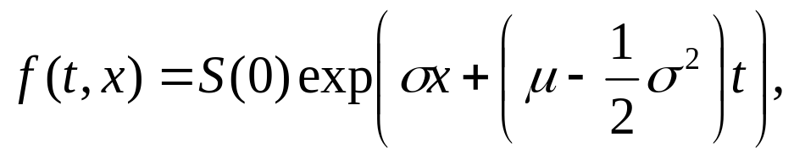

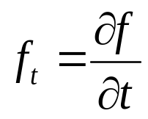
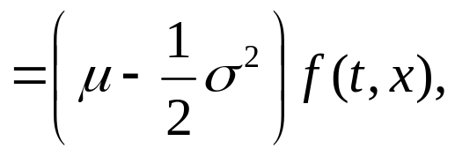
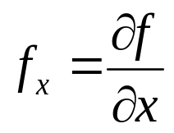
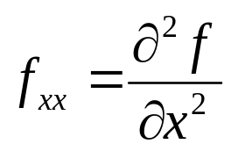



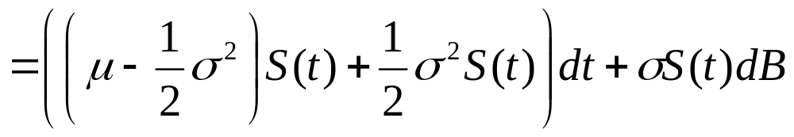


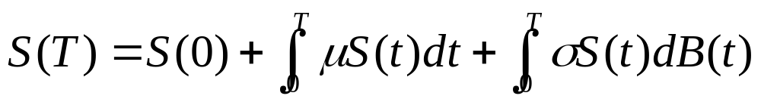
(G.B. motion in differential form)

Slide 8



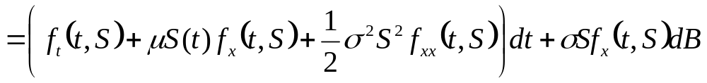

Ito’s lemma:
Differential form:

Slide 9


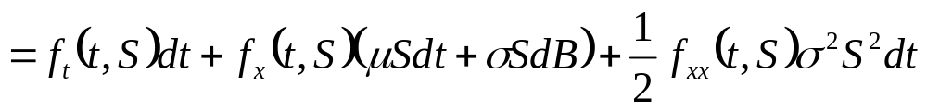
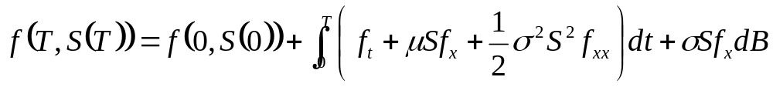
(Ito’s formula of f(t, S) in differential form)

Slide 10



Black-Scholes equation:
Stock:
Money market:
Self-financing portfolio:

Slide 11

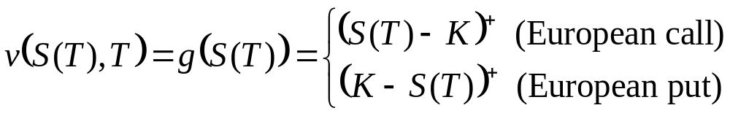
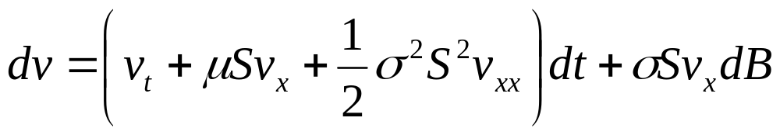
Value of an option:
- Apply Ito’s lemma for v(x, t):

Slide 12



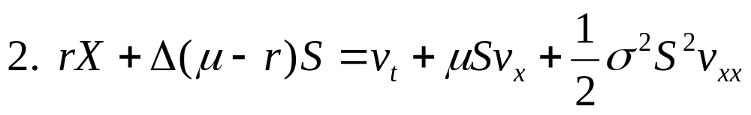
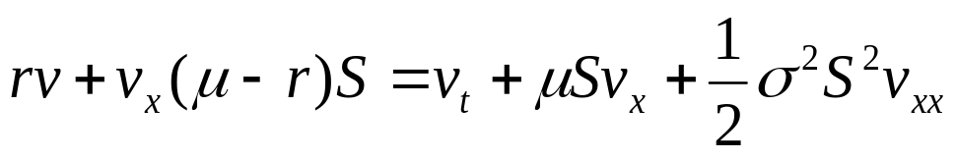
Values of option vs. portfolio:

Slide 13
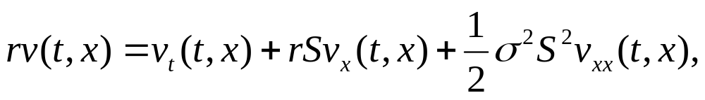




(Black-Scholes partial differential equation)
- It can be solved with various boundary conditions
- For American derivative securities,
- Black-Scholes PDE does not depend on μ

Slide 14
 | Theory | Application
Discrete
Continuous
Stochastic differential equations
Markov processes and Feynman-Kac formula

Slide 15
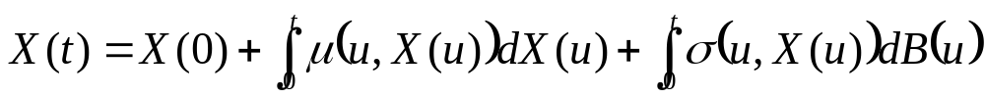
Stochastic differential equations:
How can we solve a given such equation?
What are the properties of solutions?
What are solutions?

Slide 16



Solution to SDE:
(SDE)
A strong solution
- Adapted to the filtration generated by
Brownian motion B(t),
- A function of the underlying Brownian sample path B(t)
and of the coefficient functions μ(t, x) and σ(t, x)
Is there a strong solution?
Is it unique?

Slide 17

Uniqueness of strong solutions:
(SDE)
(SDE) has a unique strong solution X(t) if the coefficient
functions μ(t, x) and σ(t, x) are Lipschitz continuous:
- There exists a constant L s.t.

Slide 18


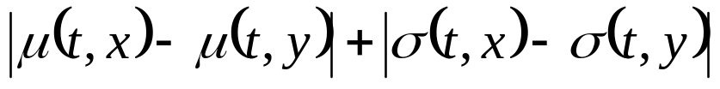
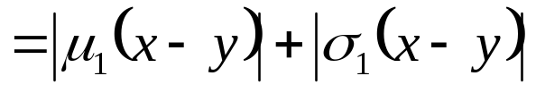
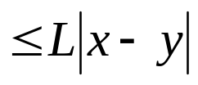
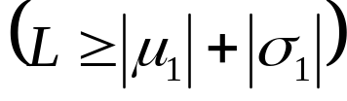
Linear Stochastic differential equation:
(L-SDE)
(Lipschitz condition)
Solve (L-SDE) using Ito’s formula!

Slide 19


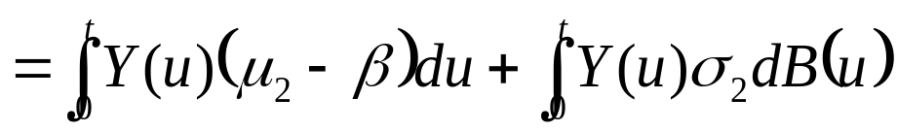

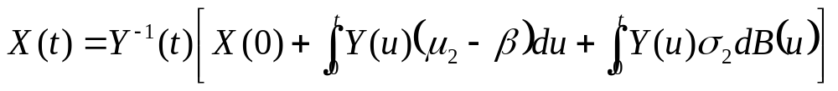
Multiply a geometric Brownian motion
=

Slide 20


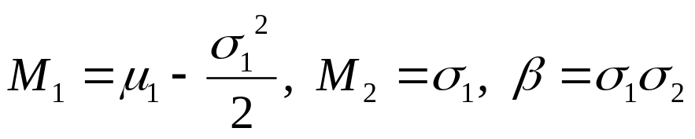


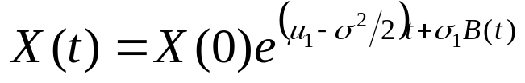
(Geometric Brownian motion)

Slide 21








Proof:
Ito formula for a function
(Integration by parts)
(Homework!)

Slide 22


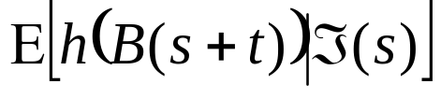
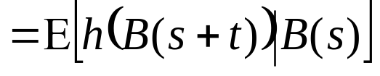

Markov property:
Brownian motion starting at x:
B(s)
0
t
s+t
B(s)
0
s

Slide 23

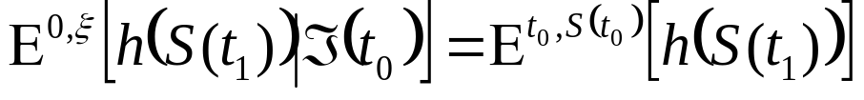




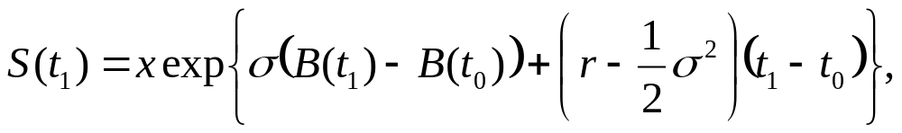


0
Geometric Brownian motion: an example of Markov process

Slide 24



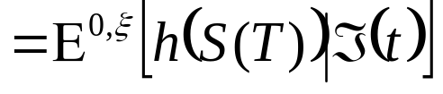
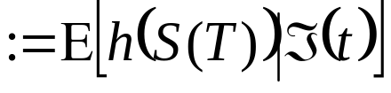

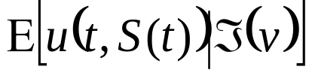
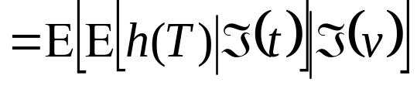
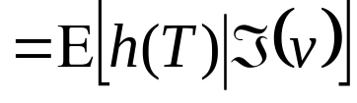


Martingale property:
Markov property:
Martingale property:

